Slide 1
Discrete Event Simulation -
Café and Bistro
MSDS 460 Decision Analytics
Requested Group: James, Garo, and Manny

Slide 2

The Problem
Objective: Improve the service of customers in a café and bistro shop setting by employing Discrete Event Simulation (DES).
Context:
Challenges often include managing resource allocation, reducing customer wait times, and enhancing overall service efficiency while meeting customer expectations and ensuring customer satisfaction.
Efficient handling of these elements is essential for ensuring customer satisfaction and operational success.
Challenges:
Balancing staffing levels with fluctuating customer demand.
Minimizing customer wait times and improving service speed.
Efficient coordination between kitchen and service staff activities to avoid delays and bottlenecks.
Focus Areas:
Optimizing resource allocation and staff scheduling.
Streamlining the sequence of service activities from seating to order completion.
Enhancing the overall experience for customers through improved operational strategies.

Slide 3
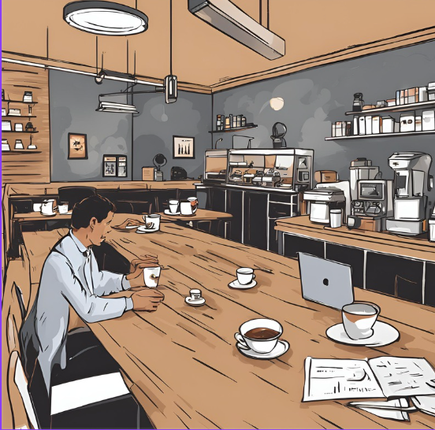
Methodology
Summary of Research Design, Algorithms, and Modeling Methods
Tools Used:
SimPy: Library for discrete event simulation.
Pandas: Data manipulation and analysis.
NetworkX: Creation of process flow graphs.
Matplotlib: Visualization of process flows and data.
Simulation Methodology:
Discrete Event Simulation (DES):
Environment Setup: Initialize a simulation environment using simpy.Environment.
Resources: Manage barista availability using simpy.Resource.

Slide 4
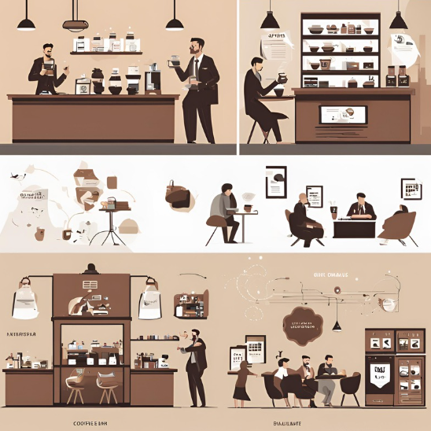
Methodology
Algorithm Implementation:
Coffee Shop Class:
Describes operations and processes (seating, ordering, preparing, serving, billing, and payment).
Activity Methods:
seat_customer: Seats customers.
take_order: Takes orders.
prepare_drink and prepare_snack: Prepares drinks and snacks.
serve_drink and serve_snack: Serves drinks and snacks.
deliver_bill: Delivers the bill.
pay_bill: Processes payment.
Process Simulation:
Simulates 1,000 customers.
Logs each activity with timestamps, order number, activity type, and barista.
Data Handling and Visualization:
Pandas: Converts logs into a DataFrame for analysis.
Process Flow Graph:
Uses NetworkX to create and Matplotlib to visualize a graph representing the sequence of activities.

Slide 5
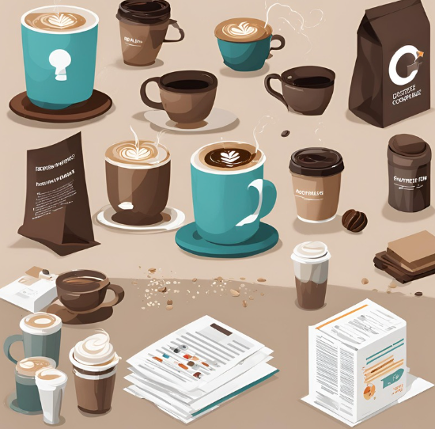
Results and Interpretation
Simulation Overview:
Total Customers served: 1000
Simulation Time maximum: 5000 minutes
Length of time for 1,000 customers: Nearly 3 full days
Key Metrics:
Average Time per Activity:
Seated: 1-3 minutes
Order Taken: 2-5 minutes
Drink Prepared: 3-7 minutes
Drink Served: 1-3 minutes
Snack Prepared: 2-5 minutes
Snack Served: 1-3 minutes
Bill Delivered: 1-2 minutes
Bill Paid: 1-3 minutes
Bottlenecks Identified:
Longest Durations: Drink and snack preparation stages.
Server Utilization: High utilization during peak times, indicating potential overburdening.
Sequential Processing: Sequential handling of orders by the same barista, leading to potential delays.

Slide 6
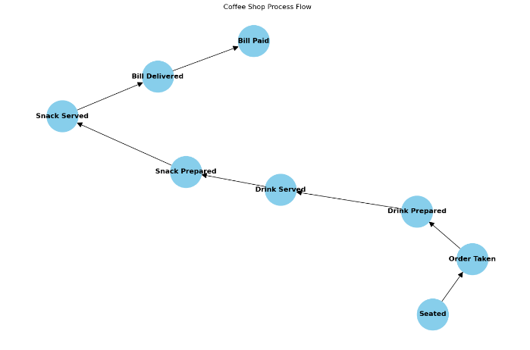
Process Flow

Slide 7

Management Recommendations
Efficiency Improvements:
Staff Optimization:
Redistribute tasks among baristas.
Increase staffing during peak hours.
Process Enhancements:
Streamline drink and snack preparation.
Allowing different baristas to handle different stages of the same order.
Technology Integration:
Introduce self-service kiosks or mobile apps.
Utilize real-time data analytics for dynamic adjustments.
Customer Experience:
Minimize wait times with a better queuing system.
Improve communication on order status.

Slide 8
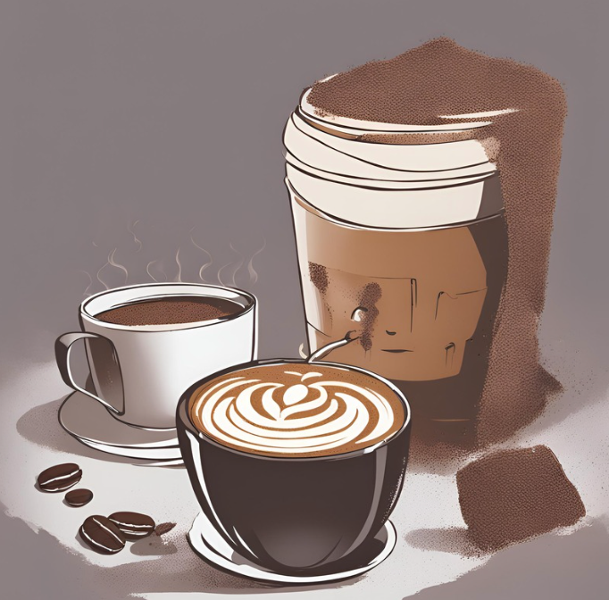
Conclusion
Challenges Encountered:
Complex Scenarios:
Balking: Customers leaving before being seated.
Reneging: Customers leaving after waiting too long.
Staying in Queue: Customers waiting despite delays.
Script Complexity: Simplified the model for better understanding due to construction challenges.
Final Thoughts:
Valuable insights gained into optimizing operations.
Addressing bottlenecks and implementing recommendations can enhance service efficiency and customer satisfaction.
Future work should incorporate more complex scenarios and refine the simulation for greater accuracy.

Slide 9
THANK YOU!

Slide 10
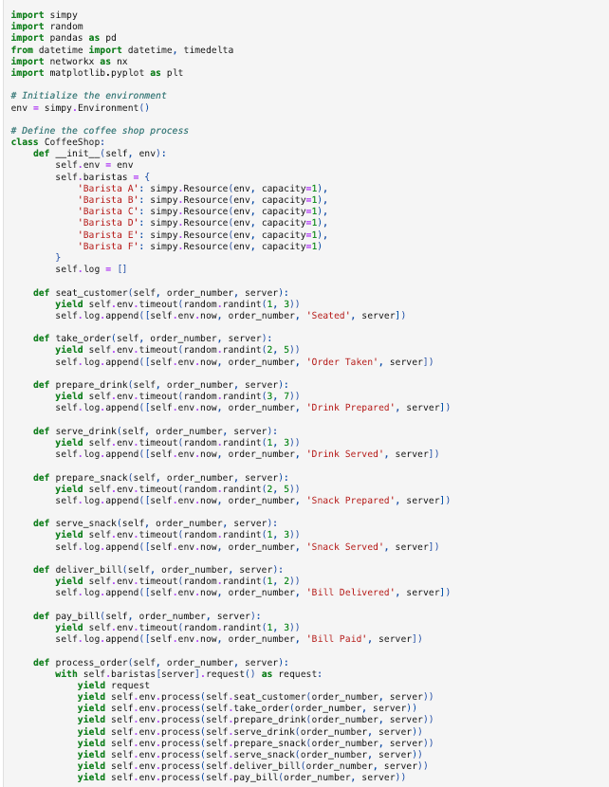
Appendix - Code

Slide 11
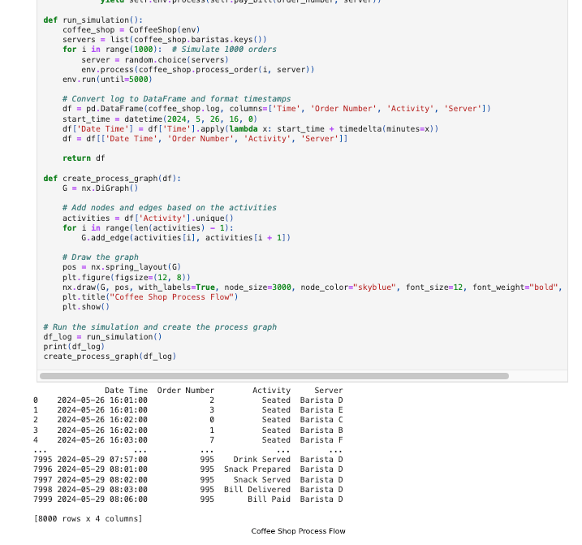
Appendix - Code

Slide 12
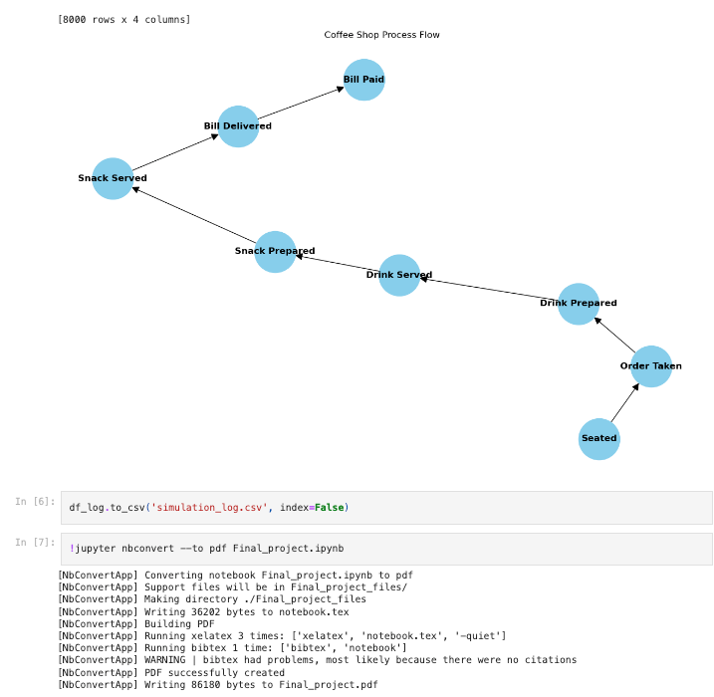
Appendix - Code

Slide 13
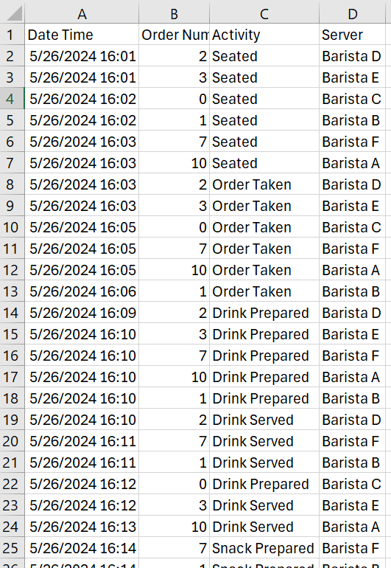
Appendix - Event Log

